Slide 1

Navigating AiTM and
Device Code Phishing
Attacks in Entra ID
HOOK,
LINE,
& SESSION
JOHN LAFFERTY
Systems Engineer – Vandalia Health
NATHAN HESS
Information Security Specialist – Vandalia Health

Slide 2
THE CREW
Who is walking you through the session.
ENGINEER
SECURITY
JOHN
NATHAN
LAFFERTY
HESS
Builds and manages the identity stack.
Secures and monitors the same stack.
20+
12
YEARS
YEARS
B.S. Computer Science
Azure Administrator
M.S. Cybersecurity
ISC2 SSCP
AWS Cloud Admin
Active Directory
CySA+ · ISC-360
AZ-900
Automation Scripting
SC-300

Slide 3
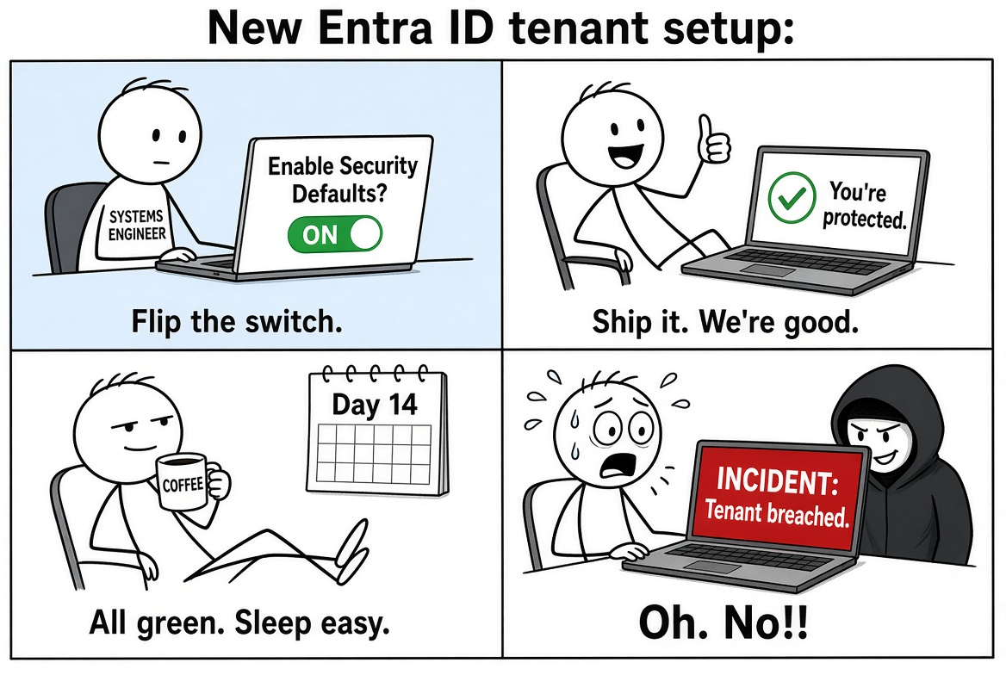
The Default Posture of Entra ID
ENABLED
≠ PROTECTED
GREEN CHECK ≠ GREEN LIGHT
Security Defaults is a starting lock.
It is not a hardening program.

Slide 4
SECURITY DEFAULTS ≠ SECURE BY DEFAULT
One free on/off switch. Useful baseline. Not a control plane.
INCLUDED · FREE
STILL MISSING · NEEDS CA
Security Defaults
Not in the switch
✓
MFA registration
✕
Session & token control
Every user has to enroll an authenticator.
No sign-in frequency or persistent-session policy.
✓
Admin MFA every sign-in
✕
Location, device, app
Privileged roles get challenged every time.
No named locations, compliant device, or app targeting.
✓
Legacy auth blocked
✕
Risk & exceptions
IMAP / POP / SMTP AUTH and old clients die.
No ID Protection policies, guests, or break-glass paths.
✓
Azure portal MFA
✕
Auth strength & guests
Resource Manager and admin portals require MFA.
No phishing-resistant MFA requirement or guest rules.
Defaults and Conditional Access cannot run together. If you have Entra ID P1/P2, disable Defaults and replace the baseline with CA — then add location, device, session, and risk.

Slide 5


TWO IDENTITY-DRIVEN ATTACKS DEFAULTS DO NOT STOP
MFA can succeed. The attacker can still leave with the session.
Adversary-in-the-Middle
Device Code Phishing
A phishing proxy relays the real sign-in and steals the password plus the session cookie. Defaults have no token protection.
The user types an attacker-generated code on a real Microsoft page. The token is issued to the attacker’s device. Defaults are not a CA policy you can tune.
Security Defaults register a method and challenge some sign-ins. They do not bind the cookie or stop these two paths.

Slide 6
IDENTITY-DRIVEN
INITIAL ACCESS
Identity policy & insider risk – 11%
65%
Credential misuse & brute force – 21%
Identity based Phishing and SE – 33%
Source: Palo Alto Unit42

Slide 7
AiTM DID NOT STAY RARE
From first disclosure to a three-day industrial wave.
APRIL 2026
2021 – 2022
2024
10,000+
10,000+
35,000
orgs targeted
attacks / month
First large Microsoft AiTM campaign disclosed
Reported run-rate against Microsoft users
users targeted in 3 days
13,000 organizations · 26 countries
Healthcare the largest vertical at 19%
Jul 23 – Jun 24
H2 25 – Q1 26
+146%
+139%
year over year
in six months
Code-of-conduct lures. Real Microsoft sign-in proxied. Session cookie stolen. MFA completed and still lost.
Microsoft Digital Defense Report 2024
KnowBe4: reverse-proxy / AiTM kits
Sources: Microsoft 2022 AiTM disclosure; Digital Defense Report 2024; Apr 2026 campaign (14–16 Apr); KnowBe4 Phishing Threat Trends Vol. 7 via PhishEye 2026.

Slide 8
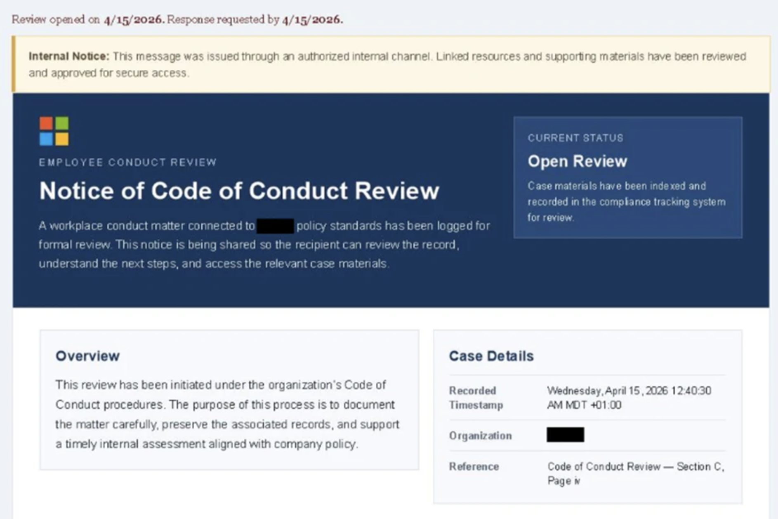
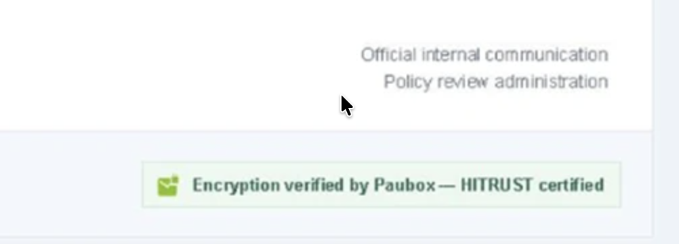
2026 Code of Conduct Campaign
Source: Microsoft

Slide 9
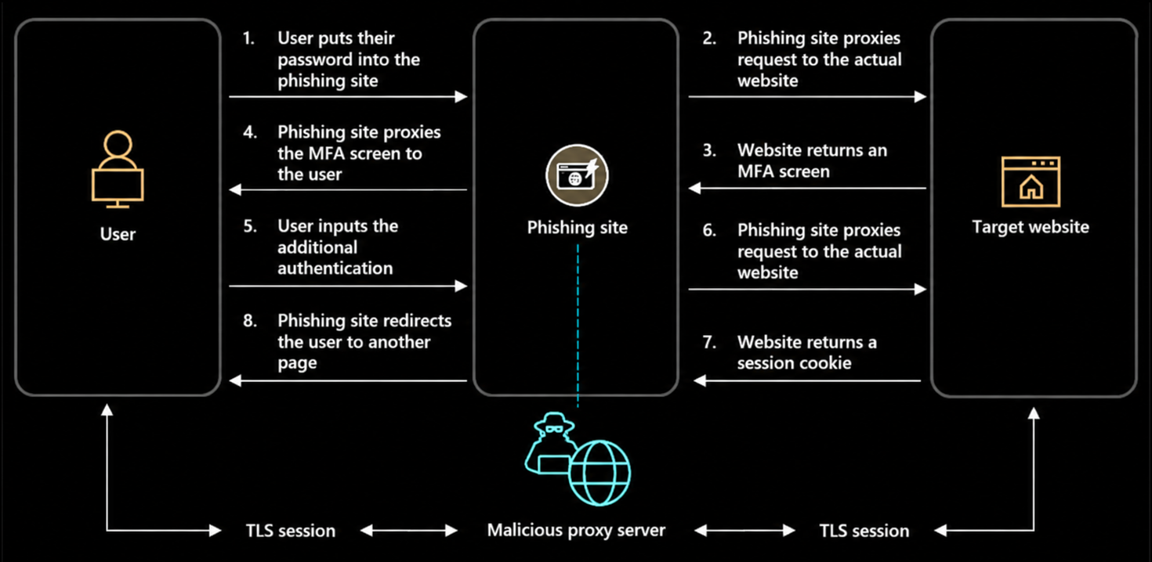
Adversary-in-the-Middle
Source: Microsoft

Slide 10
Placeholder for Video
Exceeded file size limits for GitHub

Slide 11
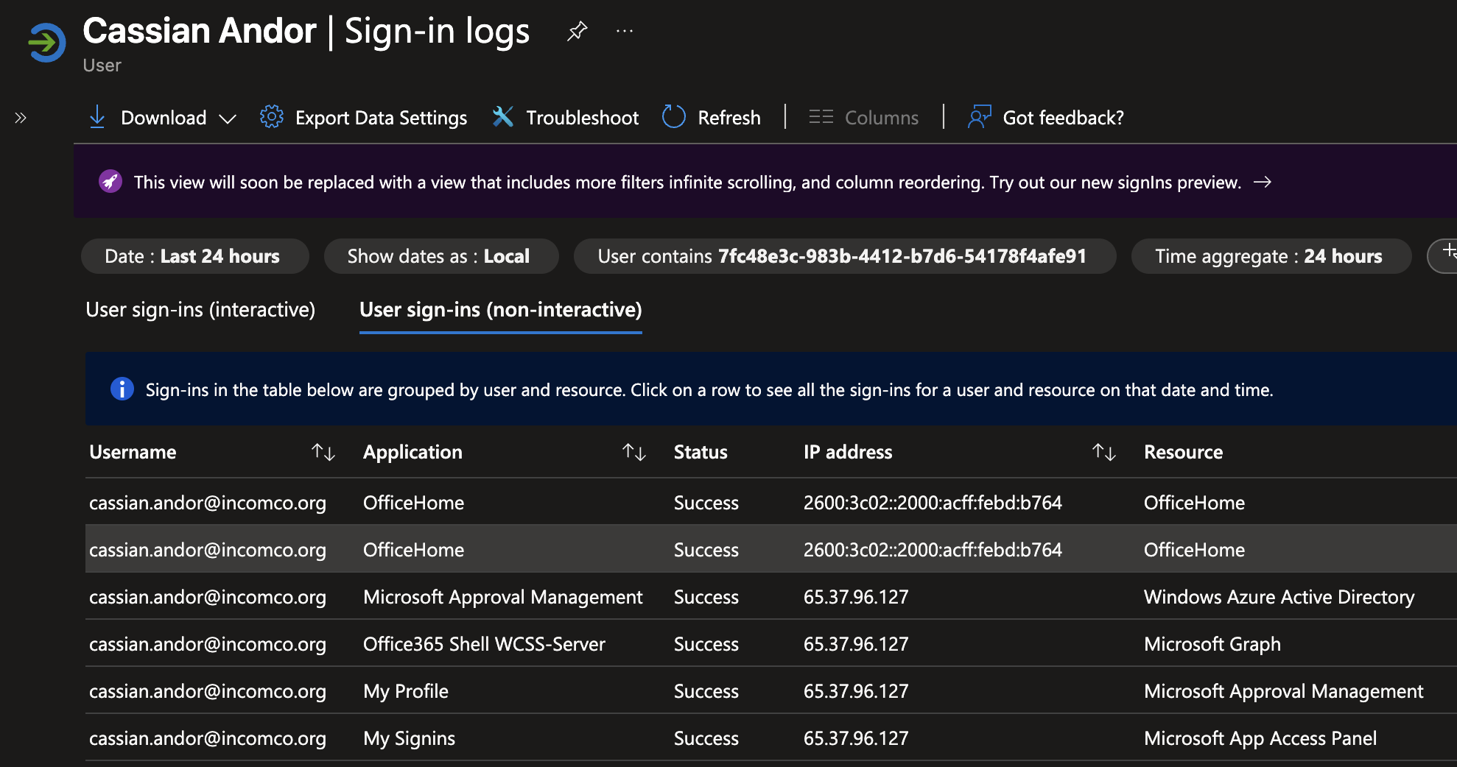
Hunting for AiTM Activity

Slide 12
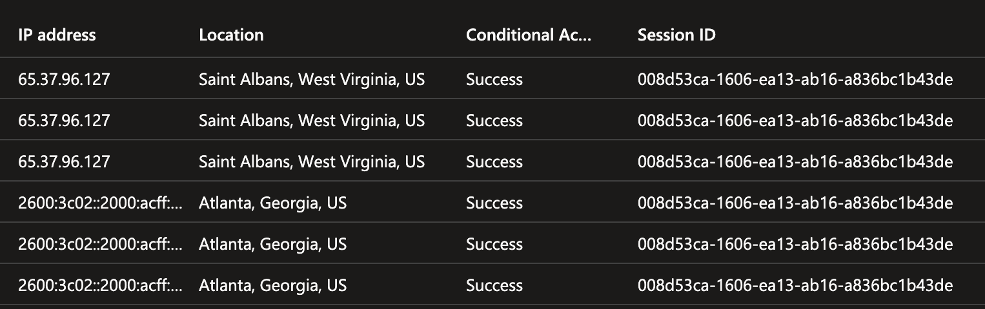
Hunting for AiTM Activity

Slide 13
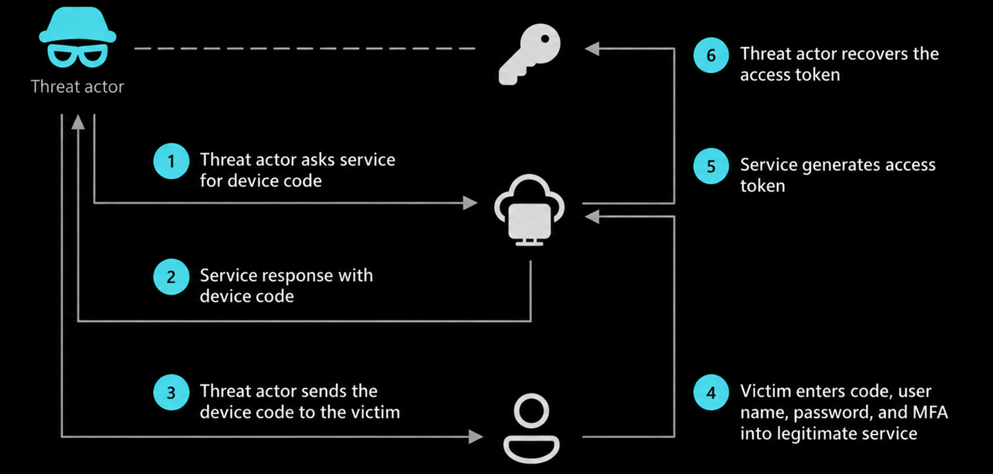
Device Code Flow Phishing

Slide 14
Device
Code Flow
DEMO

Slide 15
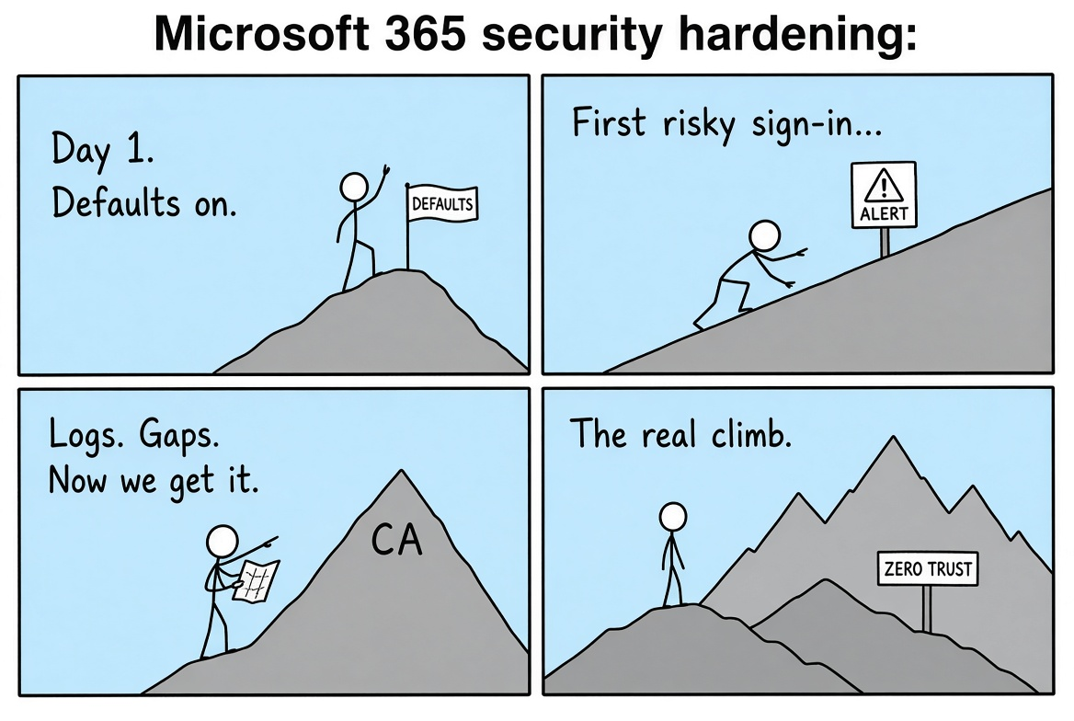
The Default Posture of Entra ID
BASE CAMP
≠ THE SUMMIT
Defaults get you on the mountain.
Alerts, logs, and CA are the climb.
01 Enable the baseline
02 Get alerted
03 Read the gaps
04 Build the posture

Slide 16

Hardening 365 Against Identity-Driven Attacks
Microsoft Entra’s policy engine for access decisions
WHAT IS
CONDITIONAL
ACCESS?
Evaluates signals such as the user, application, device, location, and sign-in risk
Applies controls in real time: allow, block, or require additional authentication
Enables organizations to enforce consistent access rules across cloud resources

Slide 17
Hardening 365 Against Identity-Driven Attacks
A FEW THINGS THAT CONDITIONAL ACCESS
ALLOWS YOU TO DO
Require MFA for all users AND apply session lifetime policies
Require additional authentication if the sign-in is deemed risky
Block all sign-ins from accounts with an active risk detections
Block legacy authentication methods
Block device code flow authentication entirely

Slide 18
Hardening 365 Against Identity-Driven Attacks
WHAT IS RISK-BASED
CONDITIONAL ACCESS?
Evaluates sign-in risk signals and applies controls when risk has been detected on an account
Anonymous IP address
Impossible travel
Anomalous Token
Malicious IP address
Atypical travel
Unfamiliar sign-in properties
These detections are great for raising flags on
AiTM and Device Code Phishing Attacks

Slide 19
Hardening 365 Against Identity-Driven Attacks
CONDITIONAL ACCESS
LIMITATIONS
Risk-based Conditional Access requires Entra ID P2 licenses
Conditional access is like checking a user’s badge at the front door. It doesn’t check to see if the people already inside are swapping badges
MAKE SURE YOU HAVE BREAK GLASS ACCOUNTS

Slide 20
Hardening 365gainst Identity-Driven Attacks
CONDITIONAL ACCESS -
TECHNICAL LIMITATIONS
Risk Detection Bypasses during AiTM and Device Code Phishing
IPv6 + Obfuscated Location and Device Properties
Signal and indicator reliability (IP Geolocation)
Timing

Slide 21
Hardening 365 Against Identity-Driven Attacks
CONDITIONAL ACCESS -
TECHNICAL LIMITATIONS
IPv6 + Obfuscated Location and Device Properties
ADD EVENT LOG SCREENSHOTS

Slide 22
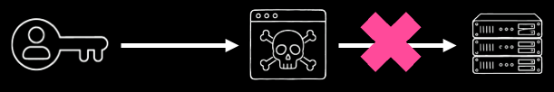
Hardening 365 Against Identity-Driven Attacks
FIDO2 /
PASSKEYS
Conditional Access Policies can also be used to enforce phishing-resistant authentication methods such as passkeys
Passkeys require physical proximity,
which breaks AiTM attacks.

Slide 23
Hardening 365 Against Identity-Driven Attacks
FIDO2 /
PASSKEYS
VS. AITM
[DEMO]

Slide 24
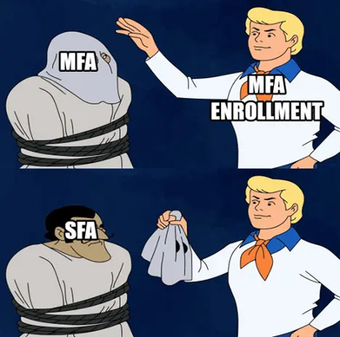
Hardening 365 Against Identity-Driven Attacks
FIDO2 /
PASSKEYS
Always require an additional authentication method (MFA, TAP, location, domain joined device) for self service portals such as Microsoft’s Security Info page.

Slide 25
THE GOOD NEWS
Microsoft built a policy to block device code flow sign-ins
All you have to do is enable it!
In September, Microsoft moved towards making Passkeys the default sign-in method for all Entra tenants
By February 1st, SMS and Voice methods for MFA will be minimally supported in Entra. Work towards moving these users to a more secure authentication method.

Slide 26
[PASS]KEY
TAKEAWAYS
Identity-driven attacks like AiTM and Device Code Flow phishing are rising year after year
Conditional Access can help detect and respond to risky sign-ins (with limitations)
Passkeys can help prevent these attacks

Slide 27
Q&A

